Slide 1

PEER TO PEER NETWORK COMMUNITY: ORGANIZATION DESIGN FOR THE 21ST CENTURY
Mila n. baker, ph.d.

Slide 2

TODAY’S CONVERSATION
Current landscape of OD today
Business Trends and Business Environment impacting Org Design
Why is it important? What impact?
Challenges and Opportunities
A (Reframing) Point of View
The Benefit and Getting Started

Slide 3
NEW JOB TITLES
Data Scientist, Data Analyst, Data Visualization Specialist, Chief Analytic Officer, Chief Data Officer, Information Strategist, Data Quality Analyst, Data Ethics Specialist, Chief Ethics Officer, Data Engineer, Data Architect, Chief Risk Officer, Chief Design Officer, Social Media Expert, Software Engineer, Digital Marketing Specialist, Chief People Officer, Chief Talent Officer, Chief Marketing Officer, Chief Information Officer, Chief Technology Officer, Chief Transformation Officer, Chief Financial Officer

Slide 4
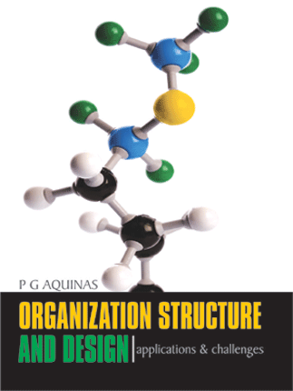
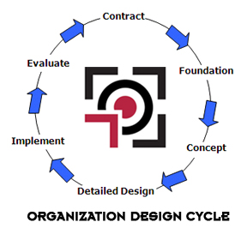
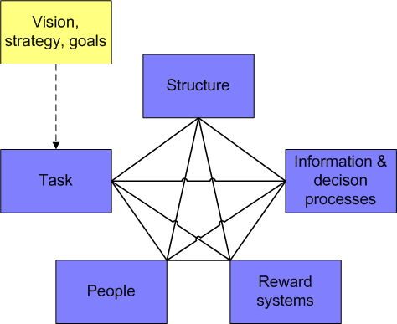
CURRENT organization design Landscape
pic 1

Slide 5
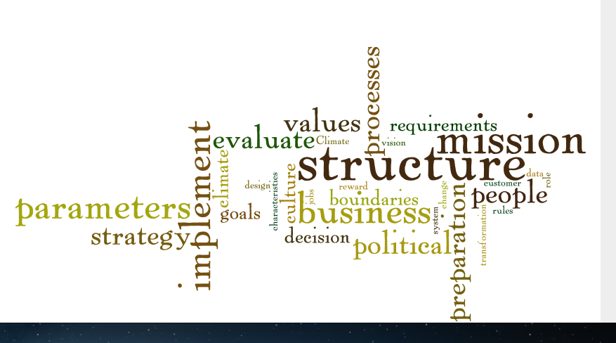

Slide 6
CURRENT organization design Landscape
(Decisions and governance)
CEO
Head
Head
Head
Head
Head

Slide 7


Business trends • business environment
Globalization – all types, all sizes
Technology Advances; Disruptive
Competitive and Regulatory pressure
Leaner companies
Acceleration of products/service into many countries; and
Aggressive global expansion
Changing workforce environment

Slide 8


diverse Workforce: who, what, where
Worker profile
Higher level of worker collaboration
New technology skills
Focus on multicultural awareness and competence
Simple work being automated or outsourced; increased knowledge work
Realignment of work and workers

Slide 9
OD models and approaches in use
Galbraith STAR Model
Requisite Organization
Agility Organization Model
Social networked organization
Holacracy
7 Step
Winby Adaptive Enterprise
Axelrod Conference Model
AlignOrg Design
McKinsey 7S Model
Weisbord Six Box Design
Nadler and Tuschman Congruence Model
Naomi Stanford; Cichocki-Irwin
KatesKessler
Parallel Learning Structures
Paul Tolchinsky Whole System Design Model
Burke-Litwin Model
Virtual ephemeral structures
Neuroscienced organization
Agora organization design

Slide 10
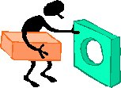
Current Reality • Current Practice

Slide 11
Importance • impact
Organizations continue to fail to achieve performance expectations following redesign
Trust in leaders has eroded
Traditional hierarchies and command and control organization models are crumbling
Technology advances are disrupting the way we work within organization
Connection, Transparency and Real Time

Slide 12

Going Forward: What’s Needed?
A framework to address the following questions
How can organizations be designed to unlock value from everyone in the workforce?
How can organizations become more nimble and resilient to today’s complexity, risk and competitive threats?
How can organizations retain people long enough to make a sustainable contribution?
How will we define leadership?

Slide 13


Slide 14
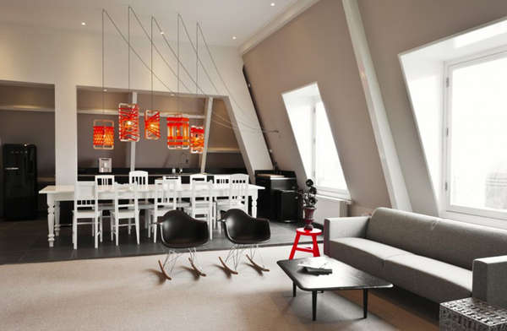
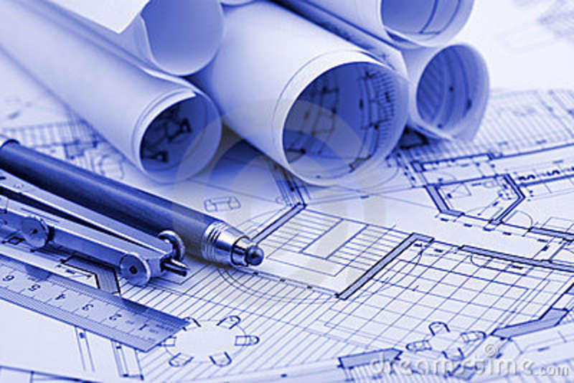


Other Disciplines: What we can learn?
Architecture and Work Design
Information Technology
Anthropology

Slide 15
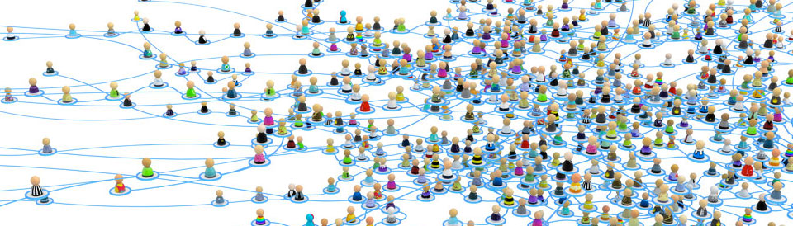
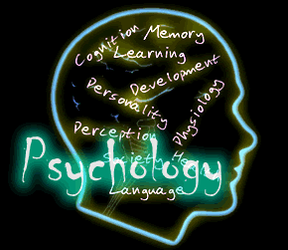


Other Disciplines: What we can learn?
Sociology
Psychology
Economics
Biology

Slide 16
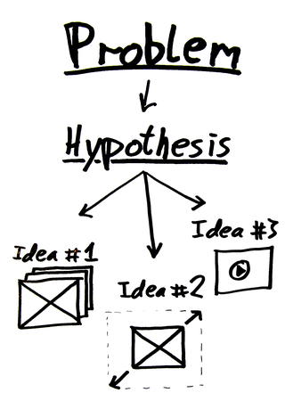
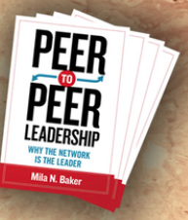
From point of view….to research agenda
The scholar practitioner journey

Slide 17

Hypothesis
Def. A supposition made on basis of limited evidence as a starting point for further investigation. Origin dates to 16th century Latin and Greek word ‘hyputhesis’ meaning foundation from – ‘hypu’ - under and ‘thesis’ - placing.

Slide 18
P2P organization architecture
Peer to Peer Network Community 
Work Environment (Public Spaces, Private Places
Work Experience (Nodes, Equipotency, Relational Dynamics)
Leadership (Dyad Exchange)
Nodes, Equipotency, Relational Dynamics

Slide 19
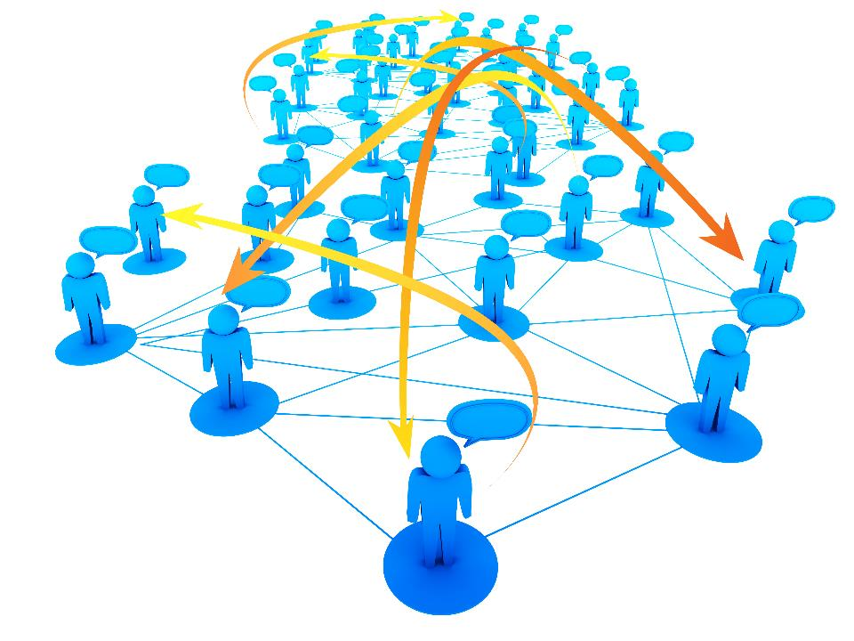
Peer to Peer Network Community

Slide 20
What is a peer to peer network community?
An organizational framework for the 21st century that integrates leadership, work environment and work experience into an interlocking organizational architecture. It is akin to distributed and collective organization and social network models but differs in that a p2p network community is distributed within and between a network of equipotent nodes (individuals) through dynamic, relational work connections.

Slide 21

Definitions
Equipotency – the capacity of each node in the network community to function as a provider or receiver given the asset needed.
Equipotent nodes – individuals within a network community that have equal authority, power and responsibility to connect with others as suppliers or consumers.

Slide 22

3 x 3 Table discussion
What three (3) questions come to mind?
What three (3) outcomes would you expect from this design framework?
What three (3) factors would you use to measure impact?

Slide 23






We already have Network Communities
Facebook
Twitter
Instagram
Linkediin
Google +

Slide 24


Getting Started
It’s a mindset shift not a process
Must assess organization readiness
Gain leader commitment and address strength of current design
Start with where the organization is currently
Focus on successive approximations

Slide 25

Stages of Organization Readiness
Stage 1: Clear understanding, commitment and communication of purpose and values
Stage 2: Mutual and continuous exchange of input and output
Stage 3: Reconciliation of polarities, tensions and abstractions
Stage 4: Formation of dyad exchange structures within a network community

Slide 26








On P2P Path

