Slide 1
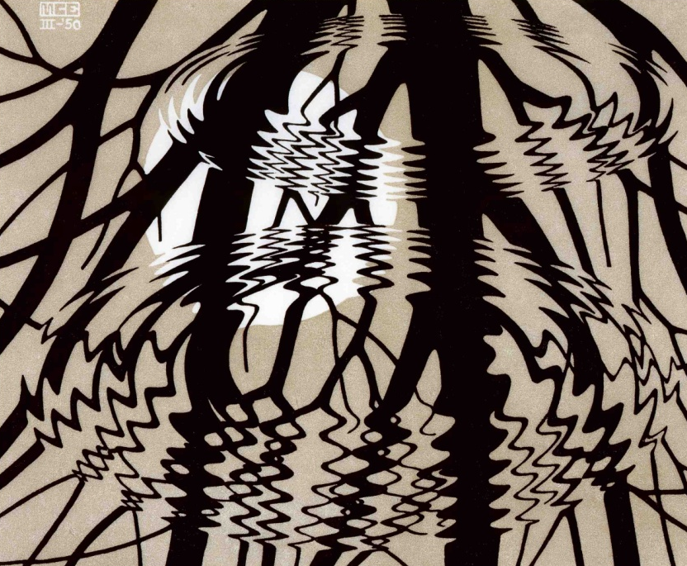
Setting Conditions for Self-Organizing Organization Design
April 29, 2014
Glenda Eoyang, PhD
Human Systems Dynamics Institute
geoyang@hsdinstitute.org

Slide 2
Self-Organizing OD
OD as Adaptive Action
Conditions for Self-Organizing
Complex Adaptive Systems
Human Systems Dynamics

Slide 3
Self-Organizing OD
Human Systems Dynamics

Slide 4
Human Systems Dynamics
Worldview
HSD
Adaptive Action
Models & Methods
Theory of
Change
Inquiry

Slide 5
What are our patterns?
Same
Different

Slide 6
Self-Organizing OD
Complex Adaptive Systems

Slide 7
Complex Adaptive System
Self-Organizing System
A collection of individual agents who have the freedom to act in unpredictable ways, and whose actions are interconnected such that they produce system-wide patterns.
Agents interact

Slide 8
Complex Adaptive System
Self-Organizing System
Those system-wide patterns, in turn, influence the behaviors of the agents
System-wide patterns emerge
Agents interact

Slide 9
Self-Organizing OD
What CASs influence your work?
So what CASs does your work influence?
Now what can you do to improve your organization design praxis?

Slide 10
Self-Organizing OD
Conditions for Self-Organizing
OD

Slide 11
Conditions for
Self-Organizing Patterns
Container

Slide 12
Containers
Anything can contain system agents:
  Organizational structures
  Charismatic leaders
  Policy, process, plans
  Physical locations
Small and tight lead to fast and more predictable self-organizing
Large and loose lead to slow and less predictable self-organizing
Container

Slide 13
Conditions for
Self-Organizing Patterns
Differences

Slide 14
Differences
Anything can be a difference, but only some are relevant:
  Measures
  Power
  Expertise
Few and clear lead to fast, more predictable change
More and ambiguous lead to slow, less predictable change
Differences

Slide 15
Conditions for
Self-Organizing Patterns
Exchanges

Slide 16
Exchanges
Any flow is an exchange:
  Resources
  Information
  Energy
Tight exchanges lead to fast, more predictable change
Loose exchanges lead to slow, less predictable change
Exchanges

Slide 17
Self-Organizing OD
What influence do you have over:
  Containers?
  Differences?
  Exchanges?
So what CDEs does your work influence?
Now what can you do to improve your organization design praxis?

Slide 18
Self-Organizing OD
OD as Adaptive Action

Slide 19
C, D, E adjust to find…
FIT and Coherence:
meaning is shared among agents
internal tension is reduced
actions of agents and sub-systems are aligned with system-wide intentionality
patterns are repeated across scales and in different parts of the system
a minimum amount of energy of the system is dissipated through internal interactions
parts of the system function in complementary ways

Slide 20

Finding FIT:
Adaptive Action
What is current FIT?
What patterns are present?
What constrains the patterns?
What energizes them?
What perspectives are relevant?
And . . .

Slide 21

Finding FIT:
Adaptive Action
So what is more FIT?
So what’s working? Not?
So what possible risks? Benefits?
So what’s happening above and below?
So what are options for action?
And . . .

Slide 22

Finding FIT:
Adaptive Action
Now what will increase FIT?
Now what will we do?
Now what have we learned?
Now what to communicate?
Now what to look for next?
And . . .

Slide 23
Finding FIT:
Adaptive Action
Next what do we expect?
Next what questions?
Next what partners?
Next what opportunities?
And . . .

Slide 24
Self-Organizing OD
What skills, insights, models, methods, attitudes do you have to support Adaptive Action?
So what is working or not working for you?
Now what can you do to improve your organization design praxis?

Slide 25
Putting it to Work
What are current patterns?
So what is
fit to purpose?
Now what could
you recommend?
Congress
School
Hospital
NGO
Bank
Restaurant
Manufacturing
Importing
Information technology

Slide 26
Self-Organizing OD
OD as Adaptive Action
Conditions for Self-Organizing
Complex Adaptive Systems
Human Systems Dynamics

Slide 27
Resources
Eoyang, G. "Toward a Computational Model of Complex Human Systems Dynamics." In How Nature Works: Complexity in Interdisciplinary Research and Applications. Heidelberg: Springer, 2014.
Eoyang, G. & R. Holladay. Adaptive Action: Leveraging uncertainty in your organization. San Francisco: Stanford University Press, 2013.
Eoyang, G. Conditions for self-organizing in human systems. Unpublished doctoral dissertation The Union Institute and University, 2001.
Olson, E. & G. Eoyang. Facilitating Organization Change: Lessons from Complexity Science. Jossey-Bass/Pfeiffer, 2001.
On the web:
  hsdinstitute.org
  adaptiveaction.org
  wiki.hsdinstitute.org

