Slide 1
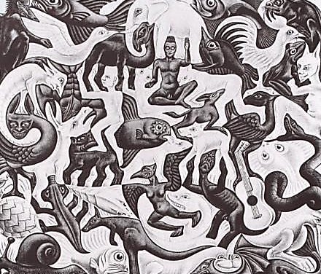
Radical Reframe:
OD as an
Infinite Game
April 30, 2014
Glenda Eoyang, PhD
Human Systems Dynamics Institute
geoyang@hsdinstitute.org

Slide 2
Radical Reframe
Now What?
How do we play?
What’s the frame?
What’s the game?

Slide 3
Radical Reframe
What’s the game?

Slide 4
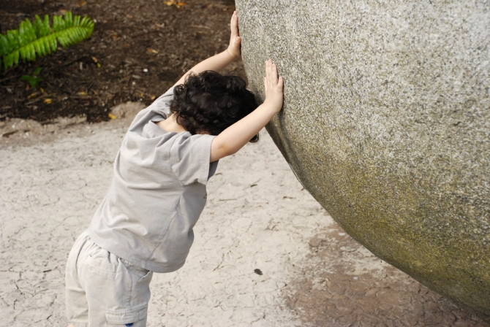
Static Change

Slide 5
Three Kinds of Change
Method
Static | Dynamic | Dynamical
Point A to point B Don’t care what happens in between Main problem: resistance Solution: push harder Examples: Outcome mgt Motivation Facilities change And . . .

Slide 6
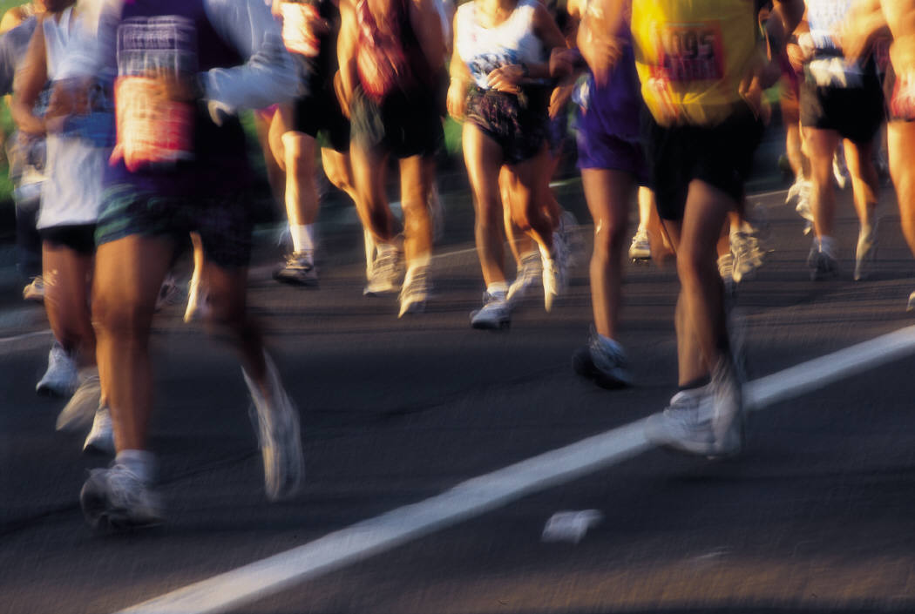
Dynamic Change

Slide 7
Three Kinds of Change
Method
Static | Dynamic | Dynamical
Point A to point B Don’t care what happens in between Main problem: resistance Solution: push harder Examples: Outcome mgt Motivation Facilities change And . . . | Follow smooth path Know initial and predict end point Main problem: disruption Solution: blame someone Examples: Project mgt Stages of change Planning And . . .

Slide 8
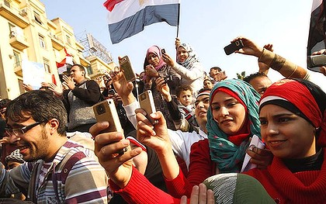
Dynamical Change

Slide 9
Three Kinds of Change
Method
Static | Dynamic | Dynamical
Point A to point B Don’t care what happens in between Main problem: resistance Solution: push harder Examples: Outcome mgt Motivation Facilities change And . . . | Follow smooth path Know initial and predict end point Main problem: disruption Solution: blame someone Examples: Project mgt Stages of change Planning And . . . | Tension and release Change at one scale bursts through Main problem: unpredictability Solution: watch for patterns Examples: Ahas in learning Innovation Economic collapse And . . .

Slide 10
Using Three
Kinds of Change
Static
Now what questions inform OD for each kind of change?
Dynamic
Dynamical

Slide 11
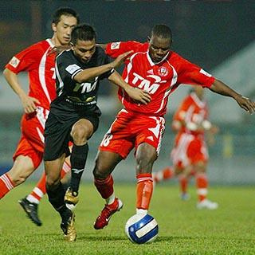
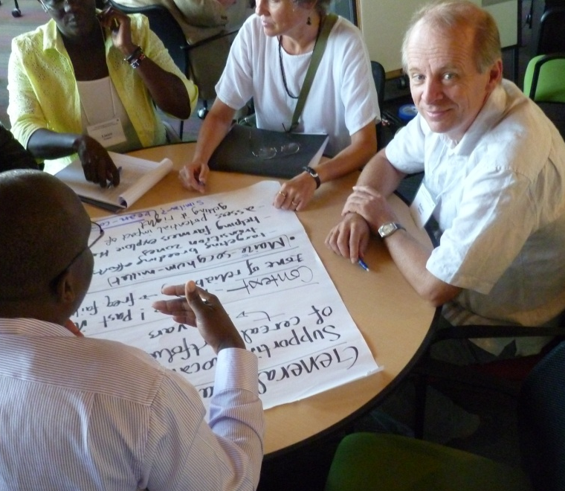
The Rules Are Changing
Finite Game | Infinite Game
Field of play Opponents Rules Expertise Purpose: To Win | Unbounded All players Changing rules Looking for fit Purpose: Keep Playing

Slide 12
The Rules Are Changing
Finite Game | Infinite Game
Field of play Opponents Rules Expertise Purpose: To Win | Unbounded All players Changing rules Looking for fit Purpose: Keep Playing

Slide 13
The Rules Are Changing
Finite Game | Infinite Game
Field of play Opponents Rules Expertise Purpose: To Win | Unbounded All players Changing rules Looking for fit Purpose: Keep Playing

Slide 14
The Rules Are Changing
Finite Game | Infinite Game
Field of play Opponents Rules Expertise Purpose: To Win | Unbounded All players Changing rules Looking for fit Purpose: Keep Playing
Now what questions inform OD for each kind of game?

Slide 15
Radical Reframe
What’s the frame?

Slide 16
Framing the Game
Finite Game | Infinite Game

Slide 17
Framing the Game
Finite Game | Infinite Game
Closed | Open

Slide 18
Framing the Game
Finite Game | Infinite Game
Closed | Open
Low Dimension | High Dimension

Slide 19
Framing the Game
Finite Game | Infinite Game
Closed | Open
Low Dimension | High Dimension
Linear | Nonlinear
Now what questions inform OD for each condition?

Slide 20
Radical Reframe
How do we play?

Slide 21
Choices for Fit
Where are you now?
What would be more fit to purpose?
How can we take action to move in the “right” direction?

Slide 22

What can you know about a CAS?
Patterns
similarities, differences, and connections that have meaning across space and time.

Slide 23
Adaptive Action
Influence Patterns
What?
Short/fast
Local/global
Private/public
Theory/practice
Formal/informal
Physical/emotional
Org/culture
And . . .
So what?
Now what?

Slide 24
Adaptive Action
See Patterns
What?
What is the pattern?
What is the same?
What is different?
What is connected?
And . . .

Slide 25
Adaptive Action
Understand Patterns
What?
So what is the tension?
So what could be:
  More same?
  More different?
  More connected?
  Less connected?
And . . .
So what?

Slide 26
Adaptive Action
Influence Patterns
What?
Now what will you do to change:
  Sameness
  Difference
  Connection
And . . .
So what?
Now what?

Slide 27
Radical Reframe
Now What?

Slide 28
Your Adaptive Action
What patterns do you see in your current projects?
So what options for action do you and your clients have?
Now what will you do to play your infinite game?

Slide 29
Resources
Eoyang, G. "Toward a Computational Model of Complex Human Systems Dynamics." In How Nature Works: Complexity in Interdisciplinary Research and Applications. Heidelberg: Springer, 2014.
Eoyang, G. & R. Holladay. Adaptive Action: Leveraging uncertainty in your organization. San Francisco: Stanford University Press, 2013.
Eoyang, G. Conditions for self-organizing in human systems. Unpublished doctoral dissertation The Union Institute and University, 2001.
Olson, E. & G. Eoyang. Facilitating Organization Change: Lessons from Complexity Science. Jossey-Bass/Pfeiffer, 2001.
On the web:
  hsdinstitute.org
  adaptiveaction.org
  wiki.hsdinstitute.org

Slide 30
Radical Reframe
Now What?
OD as Adaptive Action
Name of the Game
Patterns of Best & Worst

